Slide 1
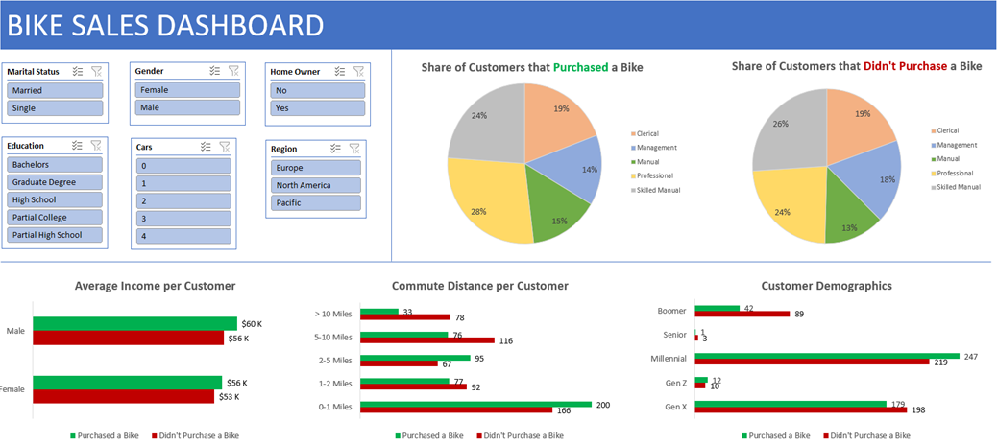

Slide 2
Abstract

Slide 3
Data Cleaning Strategy

Slide 4
Key Questions

Slide 5
Insights

Slide 6
Recommendations
Based on the following insights, I propose the following strategy for profit maximization:
Concentrate marketing campaigns in areas of the United States where millennials tend to live.
Millennials tend to live in big cities, so those areas could be an excellent starting point.
Make the bike stores closer to areas with a lot of homes.
This will shorten the commute time to the bike stores, meaning that people will most likely purchase a bike.

